Slide 1
Neleus
LAN Takeover Tool using IPv6

Slide 2
Why
IPv6

Slide 3
ATTACK OVERVIEW
Attack Vector
Goal
How we do it

Slide 4
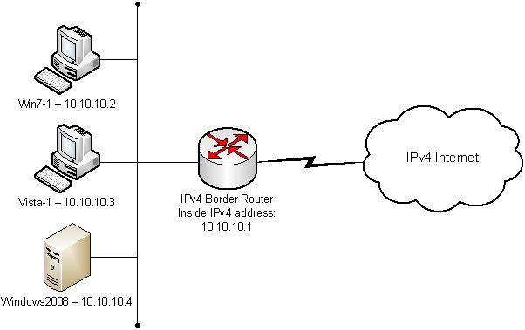
ATTACK VECTOR
IPv4-Only network
Attacker already on local-LAN

Slide 5
GOAL
Intercept all Outgoing & Incoming LAN Communication
(Perform Different Attacks on LAN)
(Offer Remote and Dynamic Communication to Neleus)

Slide 6
HOW WE DO IT
Configure IPv6 Rogue Router
Advertise Router on LAN
DNS-Spoofing with Online KeyLogger via MiTM
Remote Access using TP Server

Slide 7
Challenges

Slide 8
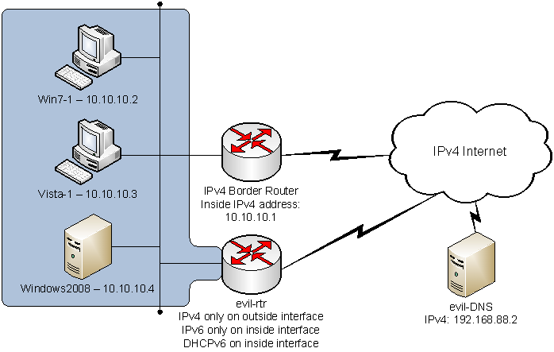
NAT-64 and DNS-64

Slide 9
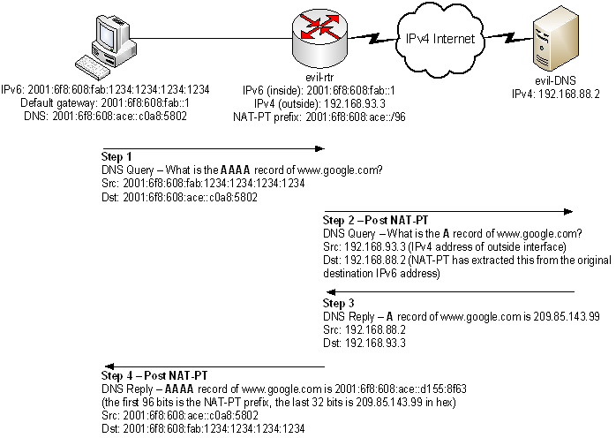

Slide 10
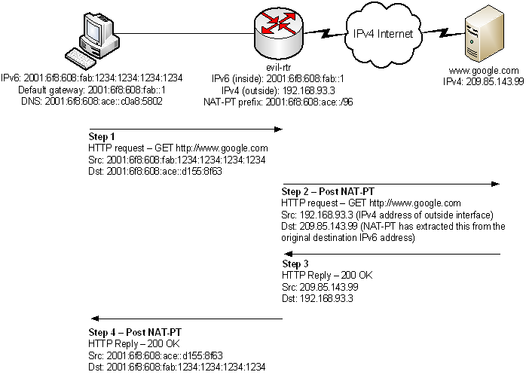

Slide 11
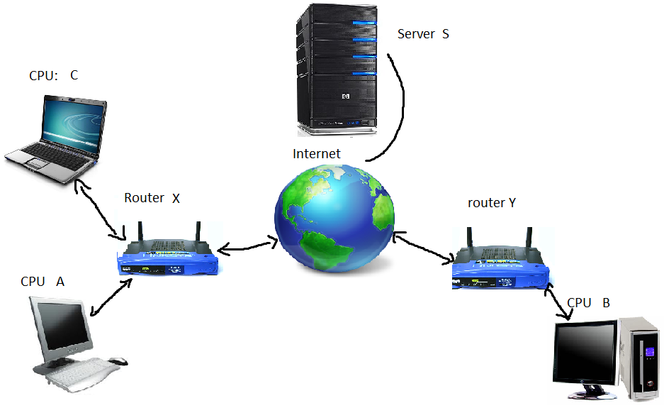
Remote Access

Slide 12
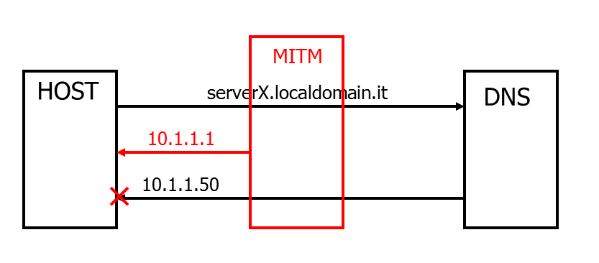
DNS-Spoofing and Stealing Info

Slide 13
RFC-6104
Rogue IPv6 Router Advertisement Problem Statement
5.3 IPv4 Networks:
The rogue RA problem should also be considered by administrators and operators of IPv4-only networks, where IPv6 monitoring, firewalling, and other related mechanisms may not be in place.
For example, a comment has been made that in the case of 6to4 being run by a host on a subnet that is not administratively configured with IPv6, some OSes or applications may begin using IPv6 to the 6to4 host (router) rather than IPv4 to the intended default IPv4 router, because they have IPv6 enabled by default and some applications prefer IPv6 by default.
Technically aware users may also deliberately choose to use IPv6, possibly for subversive reasons. Mitigating against this condition can also be seen to be important.

Slide 14
Mitigation
Manuel Configurations
Disable IPv6 on IPv4-LAN’s Hosts
RA-Snooping (RA-Guard: RFC-6105, SEnd: RFC-3971)
Many More in RFC-6104

Slide 15
Running Neleus

Slide 16
Slaac Attack

Slide 17
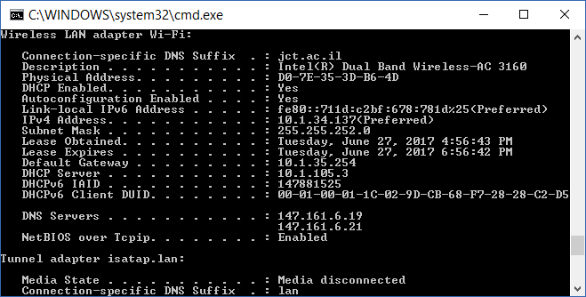
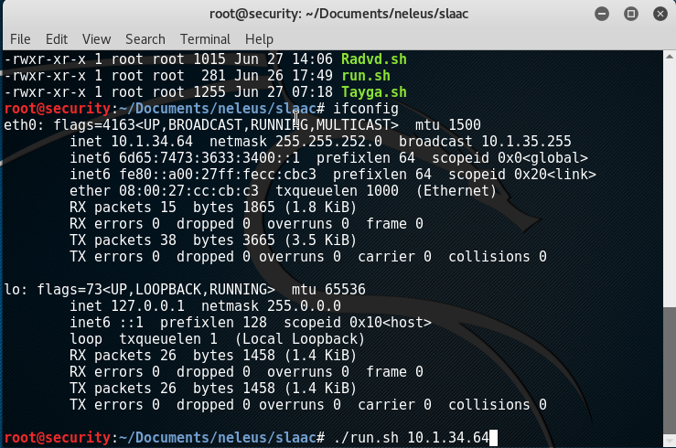

Slide 18
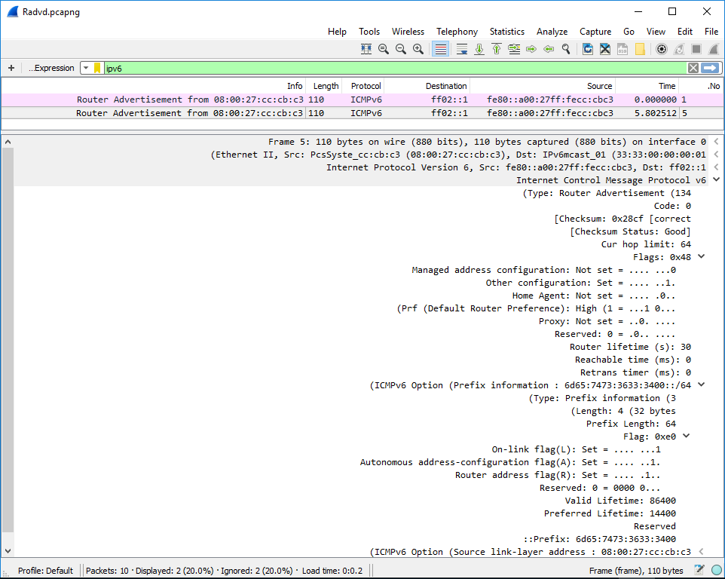
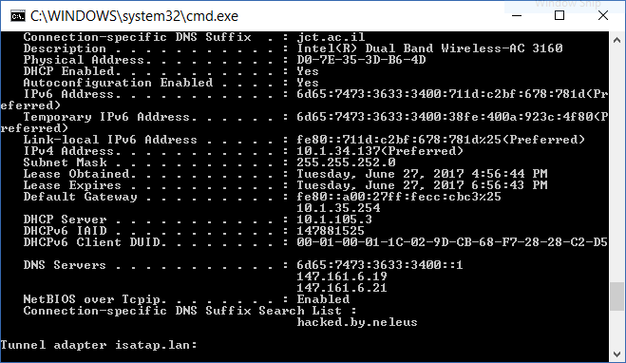

Slide 19
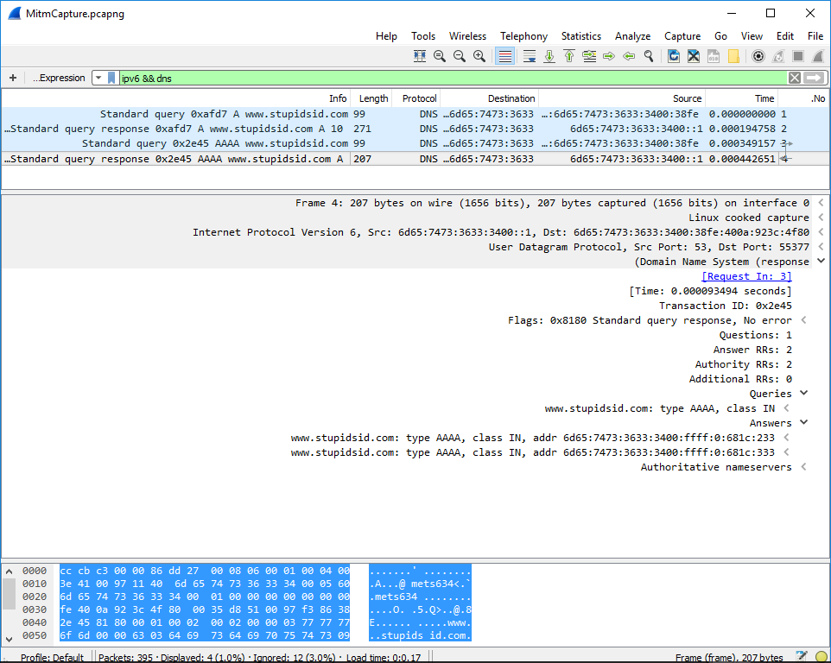
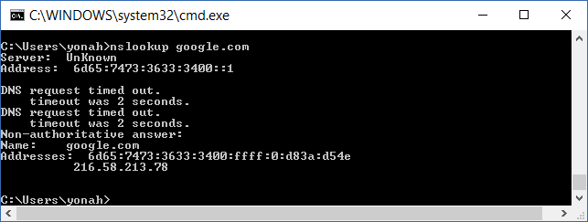

Slide 20
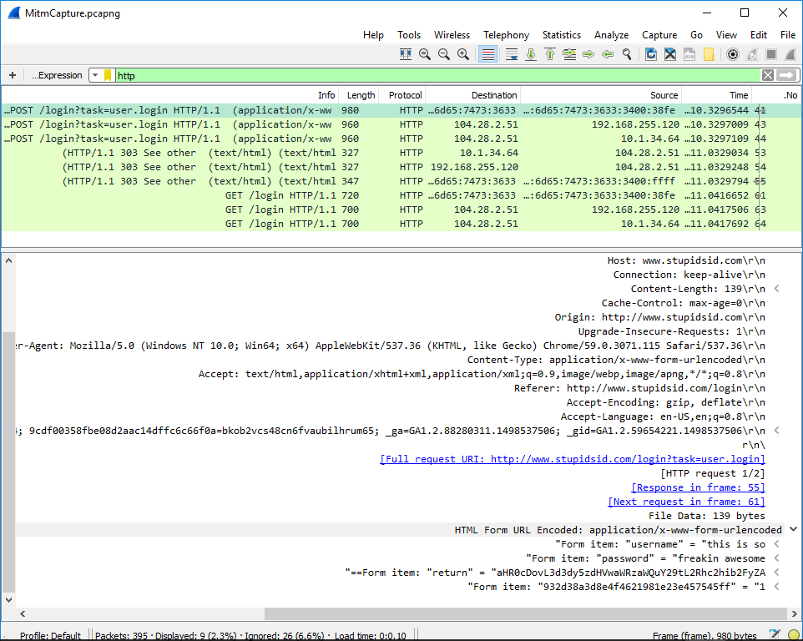
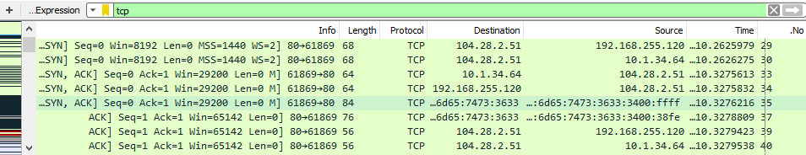

Slide 21
DNS-Spoofing
Stealing Password

Slide 22

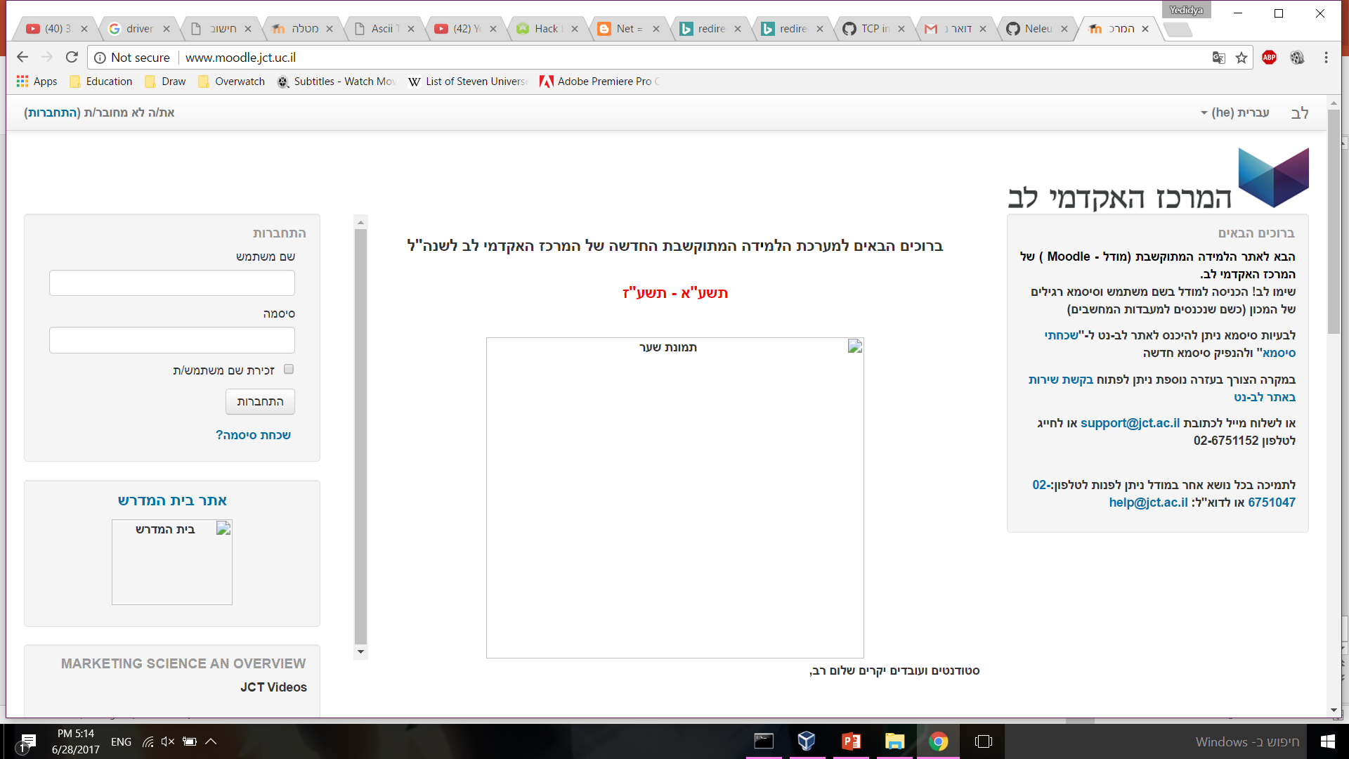
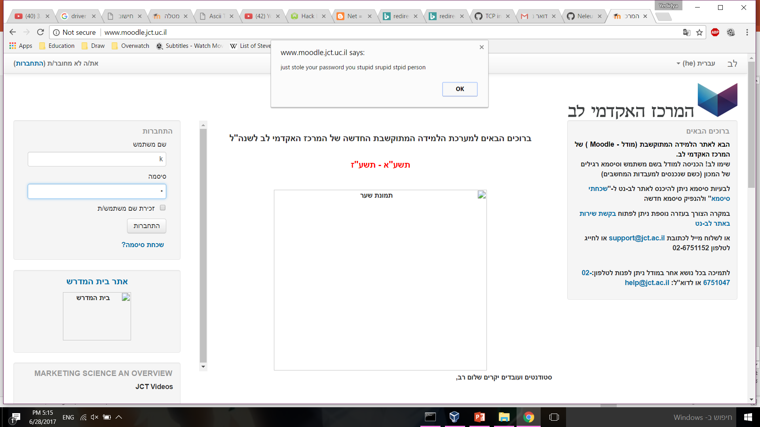

Slide 23
Remote Access

Slide 24
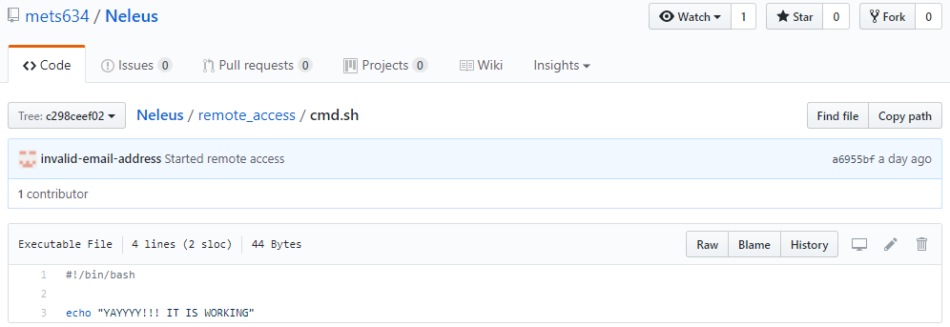
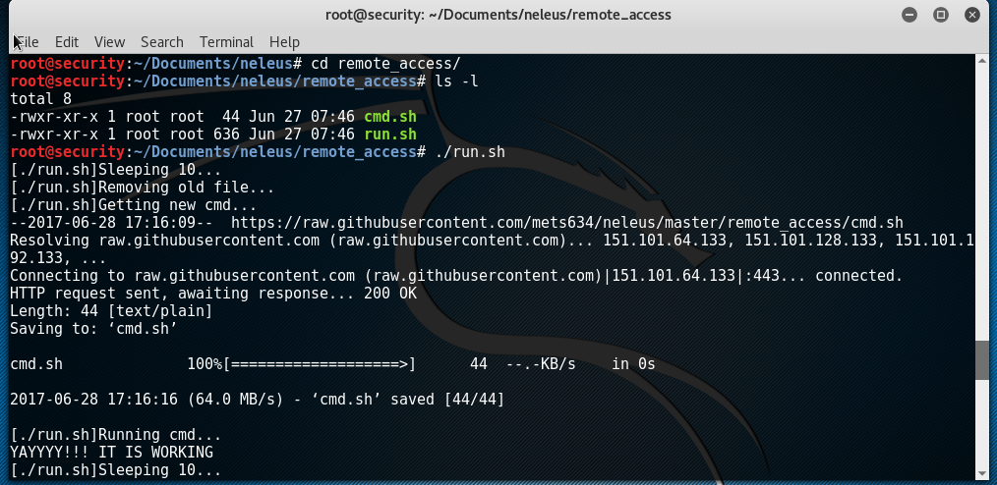

Slide 25
Any Questions?

Slide 26
Thanks For Listening!

